Slide 1

Week 2:LLVM Passes
Mohamed Ashraf-Iyad Wael
21 July 2025

Slide 2
What is an LLVM Pass?
A pass is a modular and reusable component designed to perform transformations or analysis on the IR of a program.
there are two major types of passes: Analysis Passes and Transform Passes. There also exists another category of passes known as Utility Passes.
Analysis Passes: They are designed to collect information and analyze the code without modifying anything.
Transform Passes: The are designed to modify the IR of a program to improve performance, reduce code size, or setup the code for further optimizations.
Utility Passes: Assist or manage IR data but are less common.

Slide 3
What is an LLVM Pass?
LLVM passes run during the middle-end and back-end of the compilation pipeline.
Middle-End (opt):
Applies a sequence of analysis and transformation passes.
Focuses on IR-level optimizations (machine-independent).
Examples: constant folding, dead code elimination.
Back-End (llc):
Converts optimized IR into target-specific machine code.
Runs MachineFunctionPasses and code generation passes.
Passes are scheduled automatically by the compiler or via tools like opt.
Custom passes can be inserted into these pipelines using the PassManager.

Slide 4
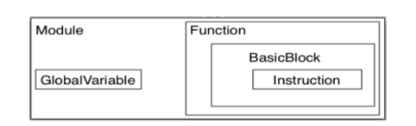
LLVM IR structure
Modules: represent the top-level structure in an LLVM program.
Functions: A single function (like in C),contains Arguments, Return type and A sequence of BasicBlocks.
BasicBlock:A straight-line code sequence with One entry and One exit.
Instruction: The smallest executable unit ex:- Arithmetic (add, sub), Logic (and, or), Memory (load, store) and Control flow (br, ret)
Value:Abstract class for anything with a value ex:-Arguments, Instructions and GlobalVariables.

Slide 5
subclasses of the base Pass class
LLVM defines six key subclasses of the base Pass class. Each operates on a different IR structure:
ModulePass: visit each module (file), It’s used for global analyses or transformations that need to look at all functions or global variables at once.
CallGraphSCCPass: Operates on Strongly Connected Components (SCCs) in the call graph.SCCs are sets of functions where each function can (directly or indirectly) call any other function
FunctionPass: visit each function in a module should not access or modify anything outside of the function.
LoopPass: focuses on individual loops inside functions
BasicBlockPass: visit each basic block in each function, should not modify anything outside of the basic block.

Slide 6
LLVM Pass Manager
The LLVM Pass Manager is a core component of LLVM’s optimization and analysis infrastructure. It is responsible for organizing, scheduling, and executing passes during the compilation process.
The Pass Manager ensures that these passes are applied in a valid and efficient order, resolving dependencies and reusing analysis data when possible, There are two main Pass Managers.
The Legacy Pass Manager, which uses inheritance and macros to register manage passes.
The New Pass Manager, which is more modern, flexible, and uses composition and explicit analysis preservation.

Slide 7
The Legacy Pass Manager
Registration & Structure
Uses inheritance-based approach (e.g., FunctionPass, ModulePass)
Passes registered globally via macros (RegisterPass<T>)
Dependencies declared manually in getAnalysisUsage()
Execution & Limitations
Fixed pass ordering (rigid pipelines)
Implicit state management
Manual analysis invalidation (markAnalysesPreserved)
Less flexible for customization
Challenges
Hard to scale with growing LLVM complexity
Debugging/maintenance difficulties due to global state

Slide 8
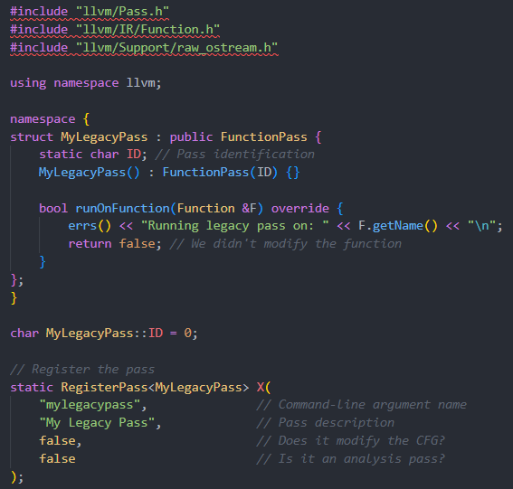
The Legacy Pass Manager
Example:-
opt -load MyLegacyPass.dll -mylegacypass test_mem2reg.ll -disable-output

Slide 9
New Pass Manager
Registration & Structure
template/mixin-based (PassInfoMixin<T>)
No macros; uses llvmGetPassPluginInfo() for registration
Explicit analysis handling via AnalysisManager
Execution & Advantages
Dynamic pass pipelines (-passes="pass1,pass2")
Automatic analysis dependency tracking
Explicit preservation (PreservedAnalyses::all())
Modern Features
Plugin-friendly (standardized .dll/.so interface)
Custom pipelines via PassBuilder (no recompilation needed)

Slide 10
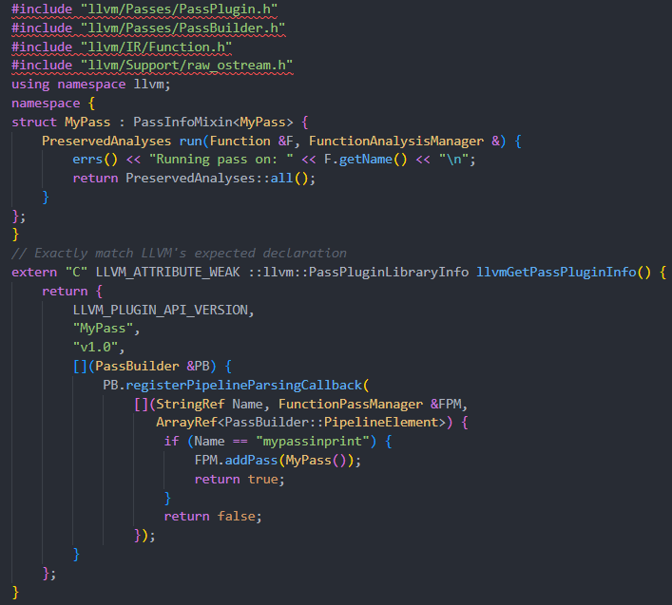
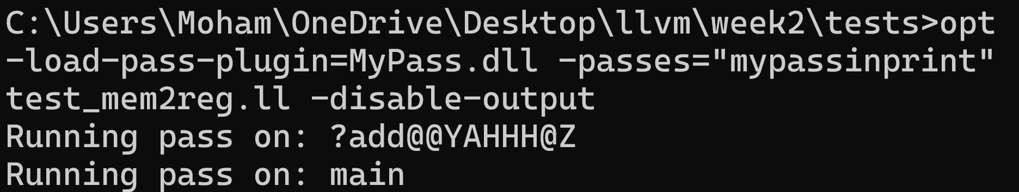
New Pass Manager
Example:-

Slide 11
Analysis Passes
Collect information about code without modifying the IR
Help other passes (especially transformation passes) make informed decisions.
Results are cached and reused across the compilation pipeline to avoid redundant computations.
in the new LLVM Pass Manager, analysis passes are treated as a distinct type of pass. They are required to define a unique identifier and follow a specific structure so that their results can be efficiently reused. This avoids repeating the same analysis multiple times and helps the compiler run faster. Although defining an analysis pass may involve slightly more setup, it leads to better organization and performance across the compiler pipeline.

Slide 12
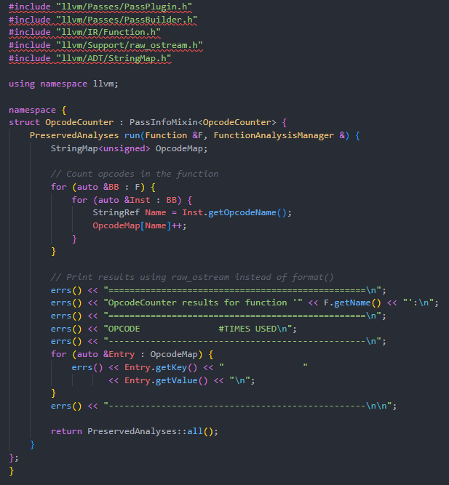
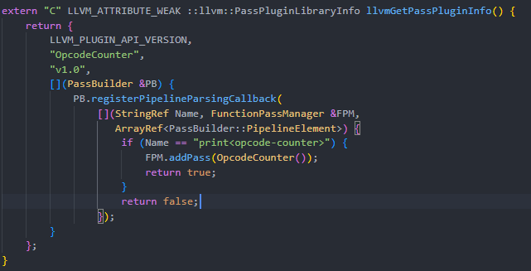
Analysis Passes
Example :-

Slide 13
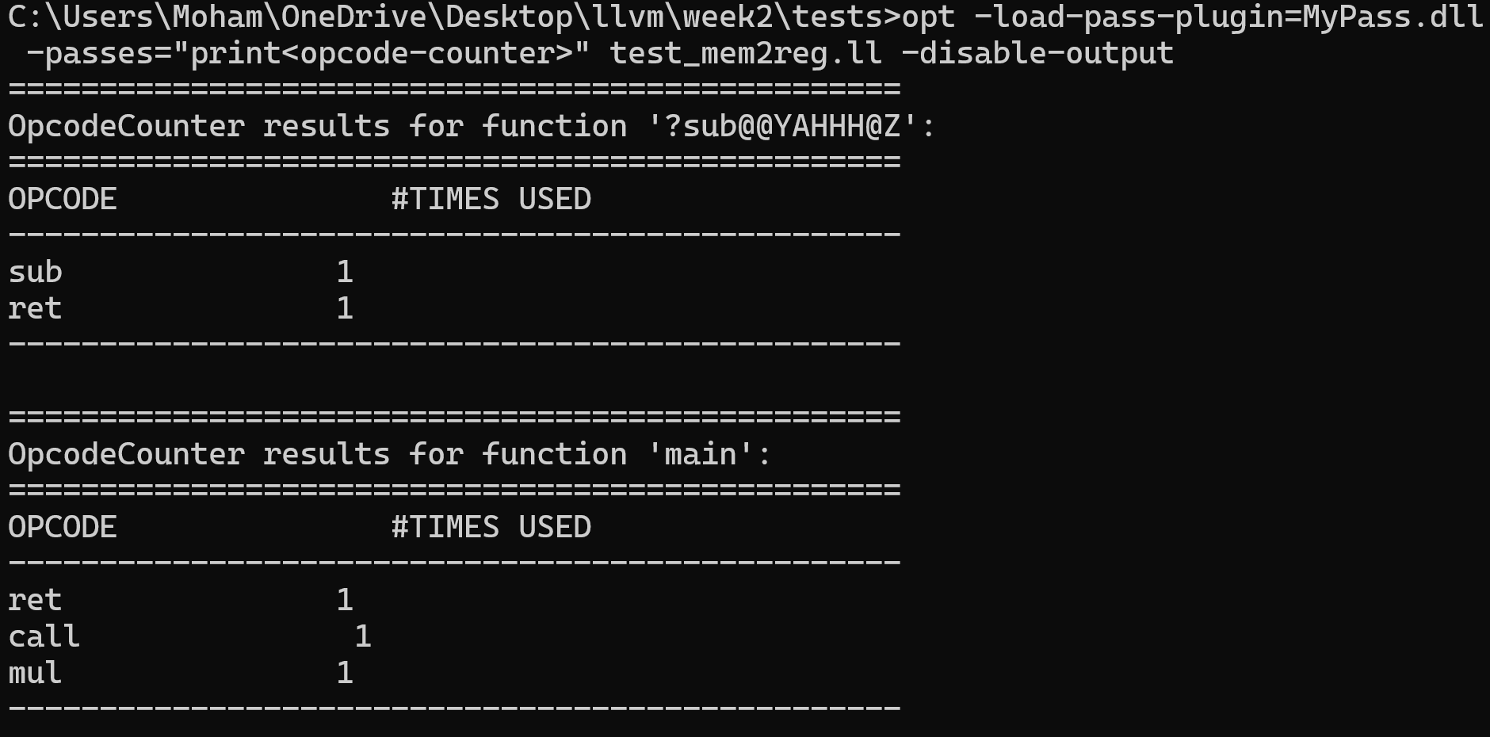
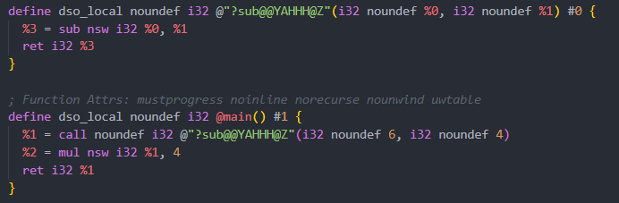
Analysis Passes
Example :-

Slide 14
Transformation Passes
Used to modify or optimize the LLVM IR.
Aim to improve performance, reduce size, or prepare code for further analysis ex:-dead code elimination, loop unrolling.
Work after or alongside analysis passes that provide helpful information.
The new pass manager provides better control over transformation sequences through explicit pass pipelines, allowing passes to be reordered or conditionally executed. Unlike analysis passes, transformation passes can change the CFG (Control Flow Graph) and SSA form, requiring them to update analysis results accordingly.

Slide 15
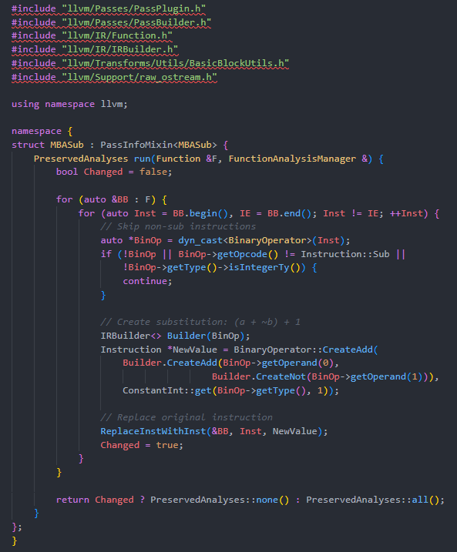
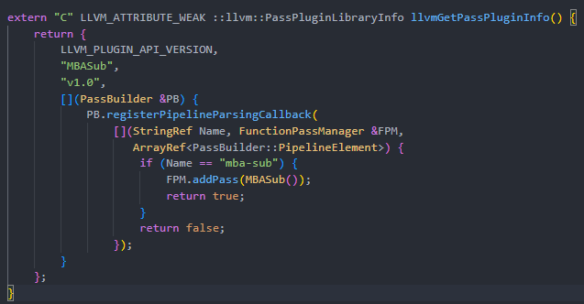
Transformation Passes
Example :-(change any A-B operation to A+(~B)+1 which is equivalent to 2’s complement of B (-B))

Slide 16
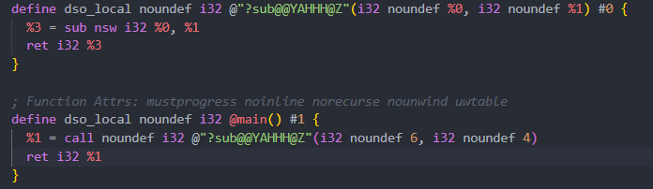

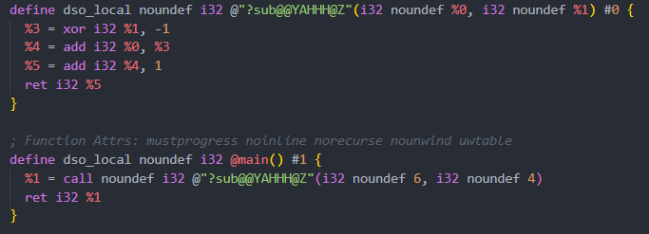
Transformation Passes
Example :-

Slide 17
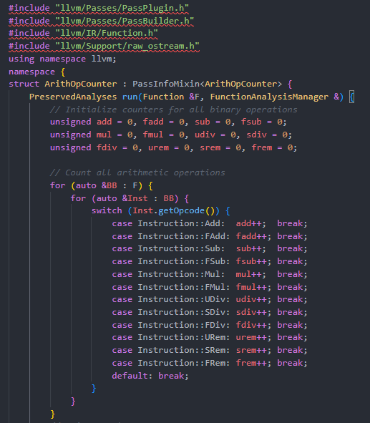
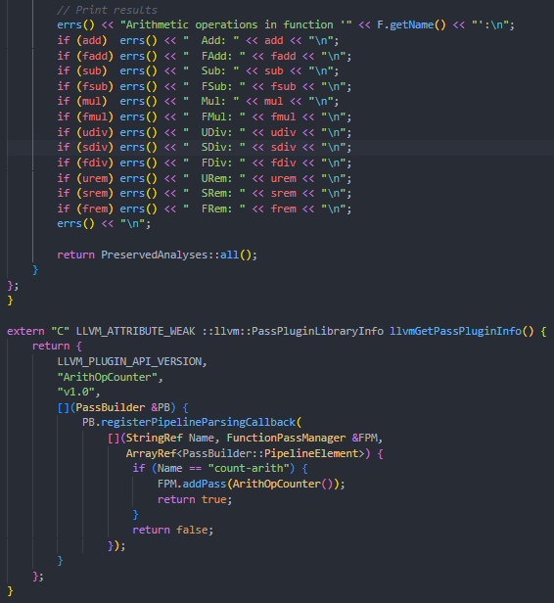
Functions arithmetic operations Counter pass
Counts all llvm arithmetic operations for each function in the IR code

Slide 18
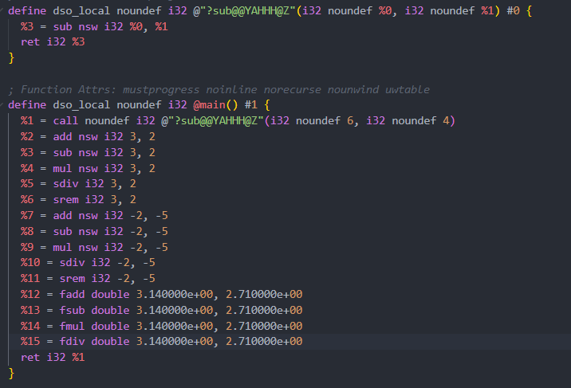
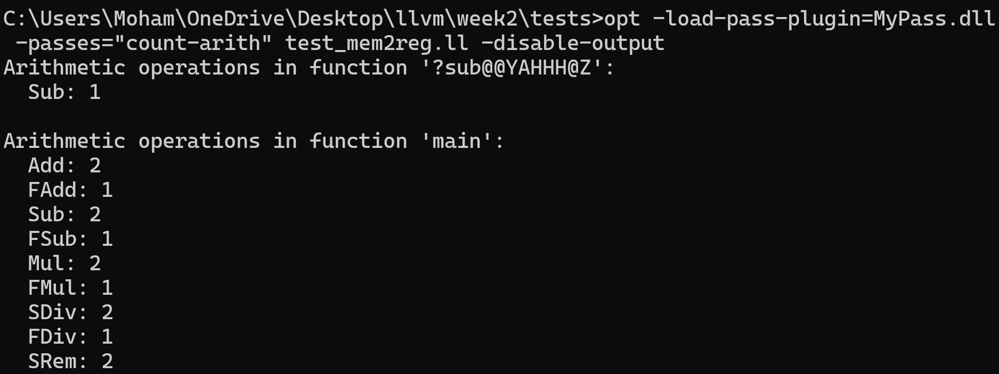
Functions arithmetic operations Counter pass

